Slide 1
Research Updates: Objective 2
Biological Soil Amendments can Support Survival of Pathogenic and Non-Pathogenic Escherichia coli in Soils and Sporadic Transfer to Romaine Lettuce
Notes:
Welcome the audience and introduce the topic: "Biological Soil Amendments and Their Impact on E. coli Survival."
Briefly mention the research focus: understanding how different soil amendments affect E. coli survival and transfer to Romaine lettuce.

Slide 2
Research Highlights
Soils were side-dressed with biological soil amendments (BSAs) to grow Romaine lettuce in environmental chambers.
Some treated BSAs facilitated a rapid decline of E. coli O157:H7 in soils.
Treated BSAs supported but did not enhance survival of E. coli in soils.
Transfer of E. coli from soils to lettuce was low and sporadic.
Notes:
Describe the experimental setup: soils were amended with BSAs, and Romaine lettuce was grown in environmental chambers.
Key findings:
Some treated BSAs led to a rapid decline of E. coli O157:H7 in soils.
BSAs supported but did not significantly enhance E. coli survival.
Transfer of E. coli from soil to lettuce was minimal and sporadic.

Slide 3
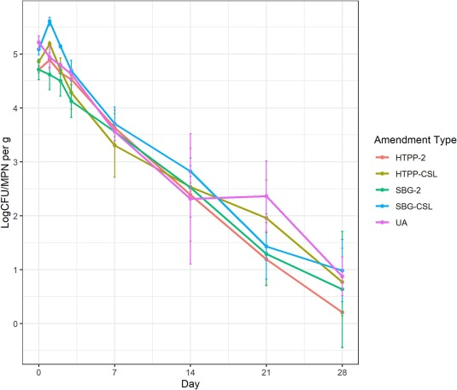
Longitudinal die-off curves of E. coli TVS 353 in soils side-dressed with different BSAs.
In most side-dressing treatment groups, both E. coli TVS 353 and O157:H7 REP strains immediately declined after day 0.
All side-dressing treatments showed declines of E. coli starting on day 2.
Notes:
Explain that this slide presents the die-off trends of E. coli TVS 353 in soils treated with different BSAs.
Note that most treatments led to an immediate decline after Day 0, with reductions observed from Day 2 onward.

Slide 4
Longitudinal die-off curves of E. coli TVS 353 in soils side-dressed with different BSAs.
For E. coli TVS 353, unamended soils took the longest number of days to achieve a 3-log reduction in soils (T_{3L}) with a value of 20.29 days, while soil side-dressed twice with heat treated poultry pellets (HTPP-2) supported the shortest T_{3L} of 17.39 days.
Unamended soils had the lowest level of reduction (log CFU/g) in soils on day 21 (L_{D21}), while HTPP-2 had the highest L_{D21}.
Notes:
Define key terms:
T3L (Time to 3-log reduction): The time required for E. coli levels to drop by 3 logs.
LD21 (Log reduction by Day 21): The amount of reduction by the 21st day.
Compare treatments:
Unamended soils had the slowest reduction (T3L = 20.29 days).
HTPP-2 showed the fastest reduction (T3L = 17.39 days).
HTPP-2 also had the highest E. coli reduction by Day 21.

Slide 5
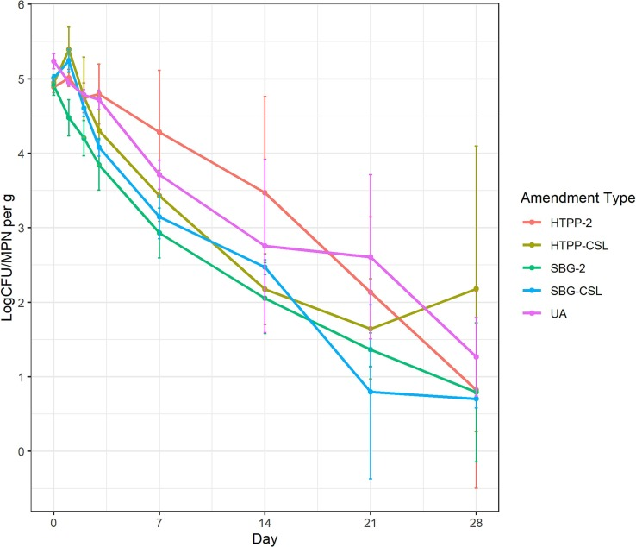
Longitudinal die-off curves of E. coli O157:H7 REP strains in soils side-dressed with different BSAs.
For E. coli O157:H7, unamended soils, again, had the highest T_{3L} with a value of 22.47 days, while soil side-dressed with heat treated poultry pellets first and corn steep liquor second (HTPP-CSL) supported the shortest T_{3L} of 13.53 days.
Unamended soils also had the lowest L_{D21} value, while soil side-dressed with seabird guano first and corn steep liquor second (SBG-CSL) had the highest L_{D21} value.
Notes:
Explain that this slide shows how E. coli O157:H7 behaves in amended soils.
Unamended soils had the longest T3L (22.47 days), while HTPP-CSL had the shortest (13.53 days).
SBG-CSL had the highest reduction by Day 21.

Slide 6
Longitudinal die-off curves of E. coli O157:H7 REP strains in soils side-dressed with different BSAs.
By day 28, all soils contained <2 log CFU/g of E. coli except one treatment, E. coli O157:H7 REP strains in HTPP-CSL (2.18 ± 1.92 log CFU/g).
Notes:
Note that by Day 28, all soils had E. coli levels below 2 log CFU/g, except for one treatment (HTPP-CSL at 2.18 log CFU/g).
Reinforce that the data suggest some BSAs contribute to faster E. coli decline.

Slide 7
More Information
Check out our paper!
Zirui Ray Xiong
Postdoctoral Research Associate
USDA-ARS
ray.xiong@usda.gov
Manan Sharma
Research Microbiologist
USDA-ARS
manan.sharma@usda.gov
This work is supported by the Specialty Crops Research Initiative [grant no. 2020-51181-32157] from the USDA National Institute of Food and Agriculture. Any opinions, findings, conclusions, or recommendations expressed in this presentation are those of the speakers and do not necessarily reflect the view of the U.S. Department of Agriculture.
Notes:
Acknowledge USDA funding (Specialty Crops Research Initiative).
Emphasize that findings are independent of USDA policy positions.
Provide contact details for further questions.
Encourage the audience to check out the related publication.

